Slide 1
Consumption and Food Security: An Examination
By: AJ, Ben, David, Swaraj for QAC380

Slide 2
RESEARCH QUESTION:
Does an increase in total consumption in dollars significantly impact food security for participants in the Rhode Island Public Health Institute (RIPHI) Food on the Move program?

Slide 3
Sample
POS Data:
Transactions at FOTM locations (2020-2023)
Observations: 772 379 after merge
Transactions recorded loyalty card numbers, how much each transaction was (in dollars), and method of payment
Survey Data:
3 Survey datasets of separate periods of time:
1) Baseline
2) 6 month
3) 12 month
Observations: 284 (baseline) + 162 (6 month) + 98 (12 month) = 544 379 after merge

Slide 4
Data Management/ Methodology
FOTM Survey Dataset
This survey gave feedback from individual users on their self reported food security, as well as vegetable and fruit consumption
POS Dataset
Combined consumption over specific time periods to get total consumption (for t=1,2, & 3).
Total observations down from 11507 to 772 after combination of all time periods
Isolated “loyaltycardnumber” to be used as our ID merge variable.
Merged Dataset
Combined total consumption and food security variables based on loyalty card number of participants
Diminished our total observations from 772 to 379 for POS and 544 to 379 for FOTM Survey.

Slide 5
Hypothesis
We hypothesized that an increase in amount of dollars spent at FOTM markets for different survey assessments (baseline (0), first follow up (1), and second follow up (2)) would be associated with improved food security when controlling for key demographic variables.
What this means:
Consumption $
USDA Food Security

Slide 6
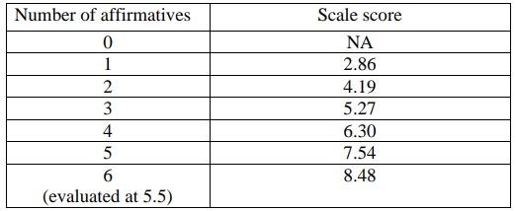
Intro to Key Variables
Independent (Explanatory)
Consumption ($ - aka Totalamount) at any FOTM locations (2020-2023)
Other variables of interest (Control)
Age, Household Size, Retired, Fruit/Veggie Consumption, Physical Activity Frequency
Dependent (Response) USDA Food Security
Key consideration: Higher foodsecurityrawscore indicates being less food secure, and vice versa

Slide 7
Figures 1 & 2 (Univariate)
Redacted due to confidentiality

Slide 8
Figures 3 & 4 (Univariate)
Redacted due to confidentiality

Slide 9
Results (Bivariate)
Redacted due to confidentiality

Slide 10
Results (Multivariate)
Redacted due to confidentiality

Slide 11
Implications
Because of the impact of COVID-19, a good portion of the data was largely affected. In the future, this can be remedied by keeping strict deadlines in terms of collection of the survey data
This solution can help keep survey data in line with POS data in terms of timing (allow for an analysis that can conclude 6mo & 12mo results)
Further data collection would be needed to fully prove our hypothesis, signs in our analysis demonstrate that SNAP has and will continue to be a useful aid in reducing food insecurity and incentivizing fruit and vegetable consumption

Slide 12
Limitations
We are not able to generalize our findings amongst all FOTM shoppers, as we had to drop many POS observations in the original POS data set due to lack of survey responses. Our findings only represent FOTM participants that responded to all three surveys during the three separate time periods
We are not able to assign specific dates to our time periods, since the result date greatly varied for all three of the survey responses
As a result of this, we have categorized the data into three categories: Time 0, 1, and 2, which are meant to represent chronological variations in the data with no specific start or end date.
The responses of the food security variable come from the individual participants’ self reports, which can be susceptible to response bias

